Slide 1
PUBLIC CLOUD DEPLOYMENT
While the name speaks for itself, a public cloud is a cloud where services are rendered by third-party providers over an open network for public use.
It’s available to the general public and data is created & stored on third-party servers.
The public cloud deployment model is one of the most commonly used cloud services. It’s a popular option for apps, file sharing, and insensitive data storage.
Under this model, the service provider owns and operates all the hardware that is needed to run a public cloud.
<number>
2
2

Slide 2
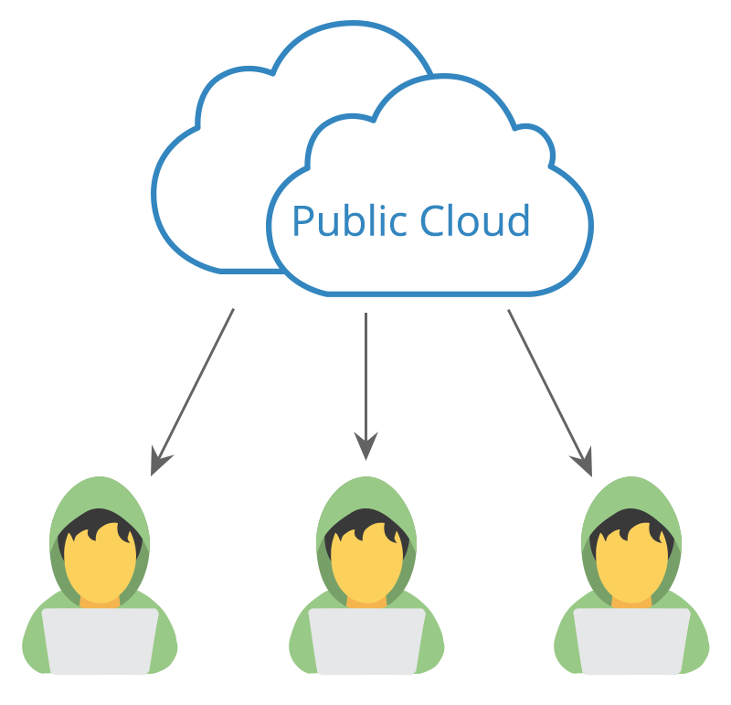
PUBLIC CLOUD
They keep devices in massive data centers. This model also plays a vital role in development and testing.
<number>
3
3

Slide 3
Advantages
• Low Cost – The service providers are the ones who fund the entire infrastructure (no need for you to invest in hardware or software).
• Convenient Infrastructure Management – The setup and use are convenient.
<number>
4
4

Slide 4
Advantages
Time – It reduces time in developing, testing, and launching new products. Aside from that, the extensive network of your provider’s servers ensures that your infrastructure is available for use 24X7.
Disadvantages
• Data and Security Risk It’s a public platform for insensitive data storage. As a result of shared resources, security risks are high.
A user is deprived of knowing where their information is being stored and who all have the access to it.
<number>
4
4

Slide 5
Disadvantages
Network Performance – Due to an increase in the number of users, the network performance suffers from instability.
• Lack of Customization – Since it’s a public cloud, personalization will always be limited.
<number>
4
4

Slide 6
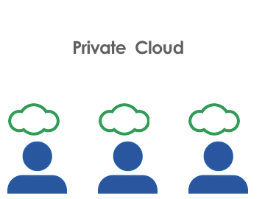
Private Cloud Deployment
A private cloud deployment model, also known as an internal or corporate model, is one that belongs to specific organizations. Under this model, the organization is the one that controls the systems and manages them.
<number>
5
5

Slide 7
Private Cloud Deployment
A a third party (a service provider) can host a private cloud server, most companies choose to keep their hardware in their on-premises data center from where an in-house team oversees and manages everything.
The private cloud deployment model is the second most used model and has it’s own pros and cons.
<number>
5
5

Slide 8
PRIVATE CLOUD ADVANTAGES
Advantages
• Customization – Unlike the public cloud deployment model, a company using a private cloud can customize its solution as per its own requirements.
• Data and Security – The security of data is high, as in, only authorized internal personnel is allowed to access data.
This makes it ideal for storing corporate data.
<number>
6
6

Slide 9
PRIVATE CLOUD ADVANTAGES
Advantages
• Control – Your organization is the exclusive owner. You get absolute control over service integrations, IT operations, rules, and user practices.
• Legacy Systems – A special feature about private clouds is that it supports legacy applications that are not functional on public clouds.
<number>
6
6

Slide 10
PRIVATE CLOUD ADVANTAGES
Disadvantages
•High Cost – Need to invest in hardware and software. Aside from that, there are also expenses for in-house staff and training. Maintenance, which is quite high.
• Limited Scalability – Private clouds are scaled within internal limited hosted resources. Scalability also depends on the choice of your underlying hardware.
<number>
6
6

Slide 11
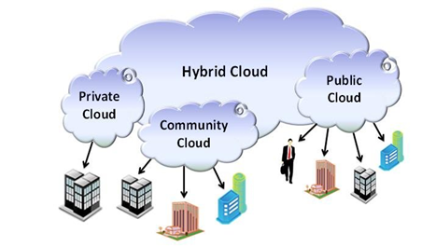
HYBRID CLOUD
<number>
7
7

Slide 12
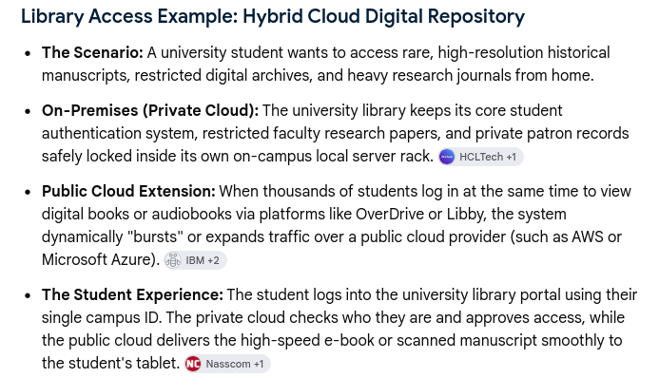

Slide 13
HYBRID CLOUD ADVANTAGES
Benefits of Hybrid Cloud
Cost-Effectiveness - The overall cost of a hybrid solution decreases since it majorly uses the public cloud to store data.
Security - Since data is properly segmented, the chances of data theft from attackers are significantly reduced.
Flexibility - With higher levels of flexibility, businesses can create custom solutions that fit their exact requirements
<number>
8
8

Slide 14
HYBRID CLOUD ADVANTAGES
Limitations of Hybrid Cloud
Complexity - It is complex setting up a hybrid cloud since it needs to integrate two or more cloud architectures
Specific Use Case - This model makes more sense for organizations that have multiple use cases or need to separate critical and sensitive data
<number>
8
8

Slide 15

COMMUNITY CLOUD
A community cloud deployment model resembles a private cloud, the only difference being the set of users. While a private cloud implies that one company owns the server.
<number>
9
9

Slide 16
COMMUNITY CLOUD
In the case of a community cloud, it is several organizations with similar backgrounds. Companies share the infrastructure and related resources on a community cloud.
This model supports joint business organizations, ventures, research organizations, and tenders, etc. Community Cloud is a way to preserve the benefits of economy of scales with the private cloud.
<number>
9
9

Slide 17
COMMUNITY CLOUD ADVANTAGES
• Cost – A community cloud is a cheaper way to avail the benefits of a private cloud. That’s because multiple companies can share the bill together.
• Data Sharing and Collaboration – With a community cloud, sharing data becomes easy and its collaborative space allows clients to enhance their efficiency. Aside from that, configuration and protocols within a community system meet the needs of the specific industry.
Disadvantages
• Limited Storage and Bandwidth– Within community systems, limited storage and bandwidth capacity become a common problem.
<number>
10
10

Slide 18
THANK YOU

Slide 19
Building Blocks of Private cloud or about different types of layers.
Looking at the essential characteristics of cloud computing – on-demand self-service, broad net-work access, resource pooling, rapid elasticity, and measured service – it is necessary as,
Infrastructure Automation, Virtualization, and Service Management are fundamental building blocks for Private Cloud.
<number>
11
11

Slide 20
Building Blocks
Cloud Service Management – by providing a set of business focused and policy-driven services, this delivers the on-demand self-service .
Infrastructure Automation(PHYSICAL OR HARDWARE LAYER)
It includes data center facility and mechanical systems as well as storage ,networks and computing infrastructure.
Each of these elements must provide enabling management interfaces to interact with higher levels of architecture.
HP, Dell are partners providing integrated and validated solutions for the hardware layer.
<number>
12
12

Slide 21
Virtualization Layer
Helps us o achieve several of the essential characteristics such as resource pooling.
Benefits
On-Demand Service Provisioning / Self-service is a primary feature of a private cloud environment. Users should be able to deploy new services on their own, or at least with minimal guidance from IT infrastructure administrators.
Multi-Tenancy – With multi-tenancy your private cloud can securely support different computing environment .
Simple Resource Scaling – As your environment grows you will have to add more resources such as RAM and storage.
<number>
13
13

Slide 22
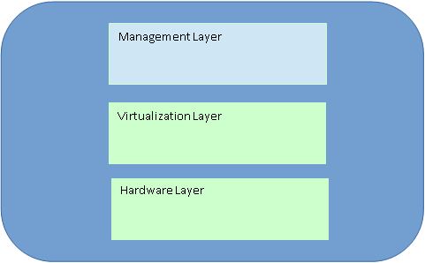
Building Blocks of Private Cloud
<number>
14
14

Slide 23
Characteristics of Private Cloud
It is a standardized solution.
Offers highest degree of virtualization.
Possible to restrict data to a group.
Possible to define the quality of end service.
Need-based pricing
High customizability
Internal security
<number>
15
15

Slide 24
Challenges in Private Cloud
Huge investments
The cloud helps saving big amounts of money – this is one of the biggest benefits of cloud computing. However, you first need to get to this place.
Shared cloud solutions do not require additional hardware and software, this is not true for private clouds, there will be investment into IT infrastructure, into space to setup the infrastructure and large amounts of bandwidth to access that infrastructure from remote locations.
<number>
16
16

Slide 25
Challenges in Private Cloud
Huge investments
At the same time, the business and the IT users have to be trained for this initiative, which adds additional costs.
This is why, it’s recommended, if not necessary, that companies analyze the long term savings and infrastructure requirements before implementing a private cloud.
<number>
16
16

Slide 26
Challenges in Private Cloud
IT Reluctance
The IT department usually handles the IT operations in a company. Once the private cloud has been implemented, less involvement of IT resources are needed.
During the migration, IT will also be responsible for working with finance, administrative departments, security, backup and disaster recovery departments when migrating over to a private cloud.
<number>
17
17

Slide 27
Challenges in Private Cloud
IT Reluctance
So many changes and the unknowns of their role going forward usually make people from IT departments reluctant and it’s easy to see why.
To facilitate this process, the management team should be involved with IT early, to explain the benefits of the migration and work on cross training the IT team to help with core competency initiatives that benefit the companies bottom line.
<number>
17
17

Slide 28
Challenges in Private Cloud
Defining the IT cost model
This is a very important issue. Once the cloud services have been implemented, how will the company allocate costs back to departments? Will it be time based or resource usage based.
IT will be part of defining a clear cost model.
<number>
18
18

Slide 29
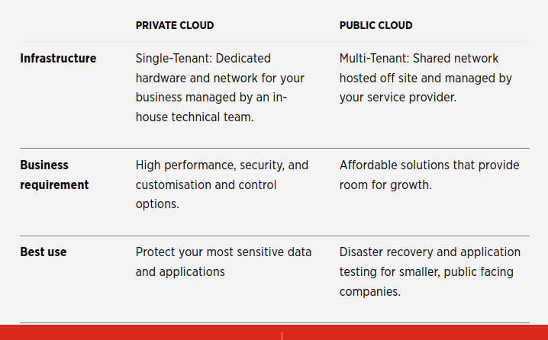
PUBLIC CLOUD VS PRIVATE CLOUD
<number>
19
19

Slide 30
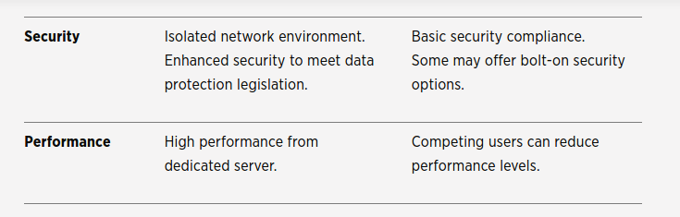
PUBLIC CLOUD VS PRIVATE CLOUD
<number>
20
20

Slide 31
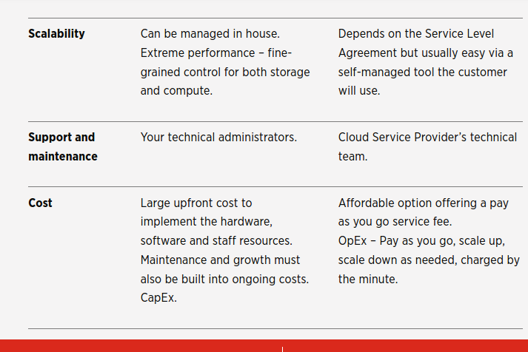
PUBLIC CLOUD VS PRIVATE CLOUD
<number>
21
21

